Slide 1
Course: SWE250 Space Android Development Project
Project Name : Tour Guide
space
Project Submitted By : Tasmia Alamgir (2016831022);
Sabrina Nusrat Ayvi (2016831032);
space
Project Instructor : Quazi Ishtiaque Mahmud Rafi
Lecturer, IICT, SUST.

Slide 2
Project Introduction:
The Initial idea of this project is to building an android based tourism application. A user can search for a desired location under certain types and see posts by other users . Also can view this location via Google Map Navigation .

Slide 3
Features:
Authentication (using Firebase)
Creating Post
Search by Location & Type (Food , Hotel, Places)
Show in map (radius 10 km)
Showed in Detailed Post
Radius Fixation

Slide 4
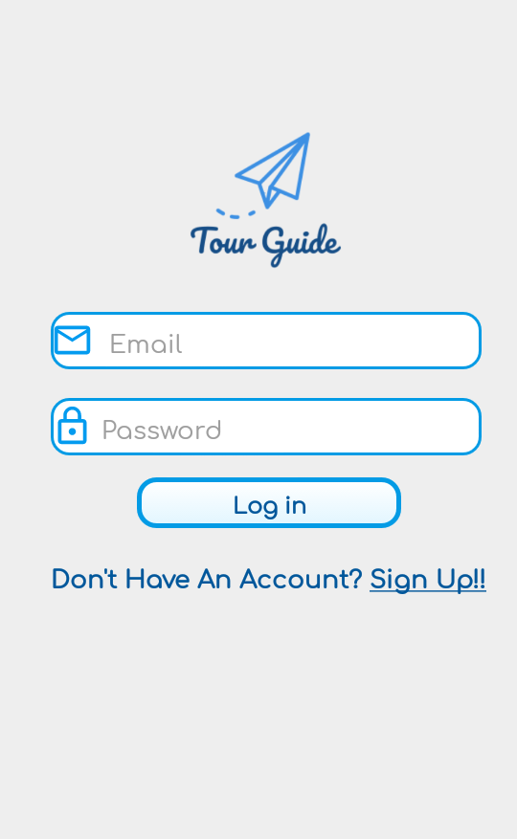
Authentication:
Place your screenshot here
User have to authenticate himself first by inserting email address and password. For authentication setup, Google Firebase tools have been used .User information are stored in Firebase Database after signing up.

Slide 5
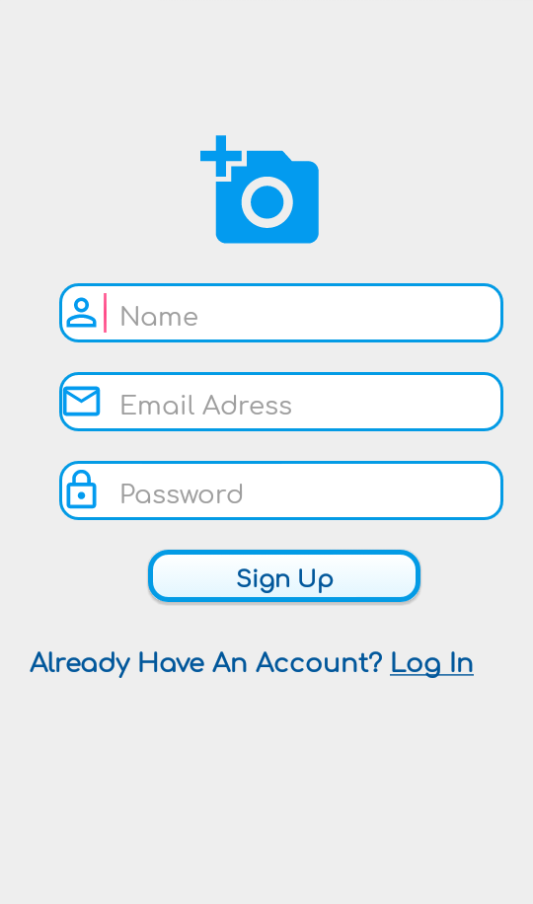
Authentication:
Place your screenshot here
User have to authenticate himself first by inserting email address and password. For authentication setup, Google Firebase tools have been used .User information are stored in Firebase Database after signing up.

Slide 6
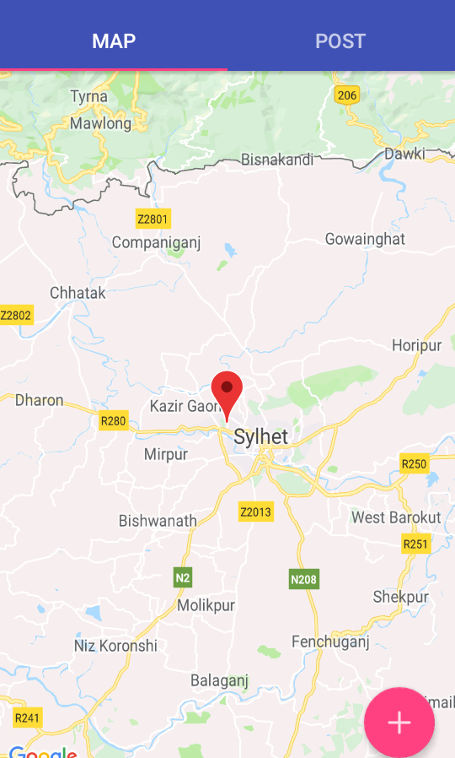
Opening View:
Place your screenshot here
In opening , user feed is shown . This includes map navigation and post view . Android default tabbed activity is used for UI and Google Map API has been used to show user’s current position.

Slide 7
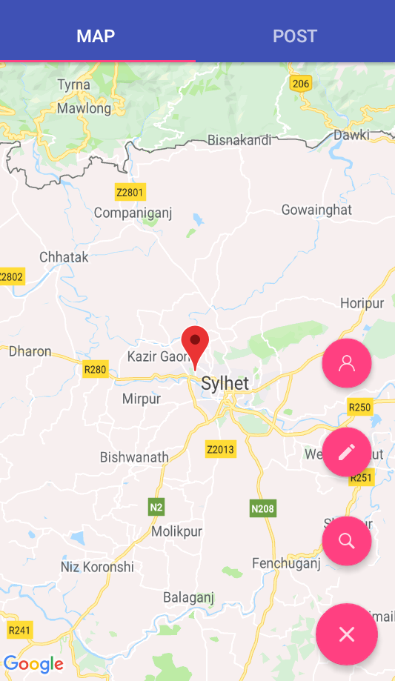
Options:
Place your screenshot here
From the right bottom corner of opening activity , user will find four options to search for a location, create a post and showing own profile.

Slide 8
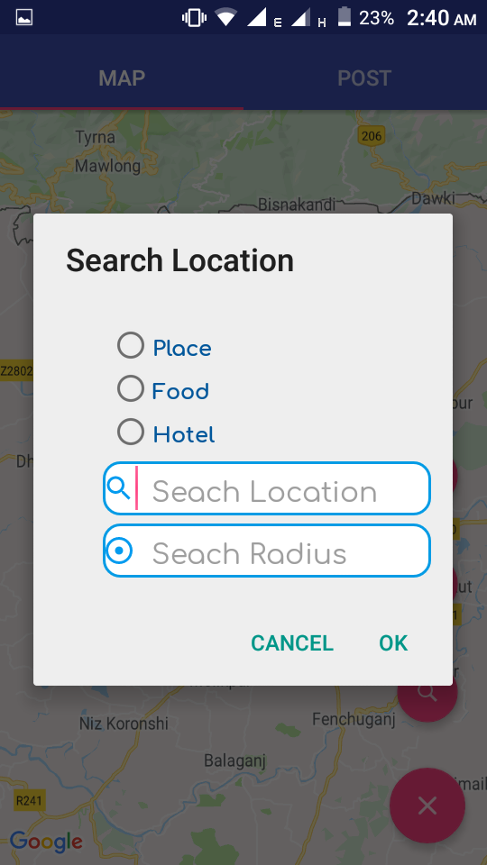
Search Location:
Place your screenshot here
The popped up dialog box takes input about the category user wants to search for and the location . User can also fix the radius and search within it.

Slide 9
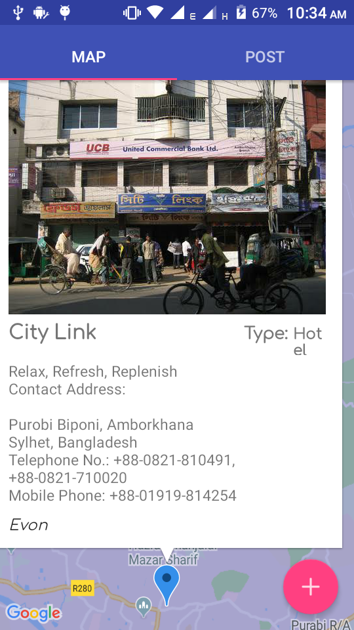
Showing in Map:
Place your screenshot here
User can view search results in the map. Tapping on marker will show the detailed posts. For each tap , different posts will be shown up if there’s multiple posts are done at the same location.

Slide 10
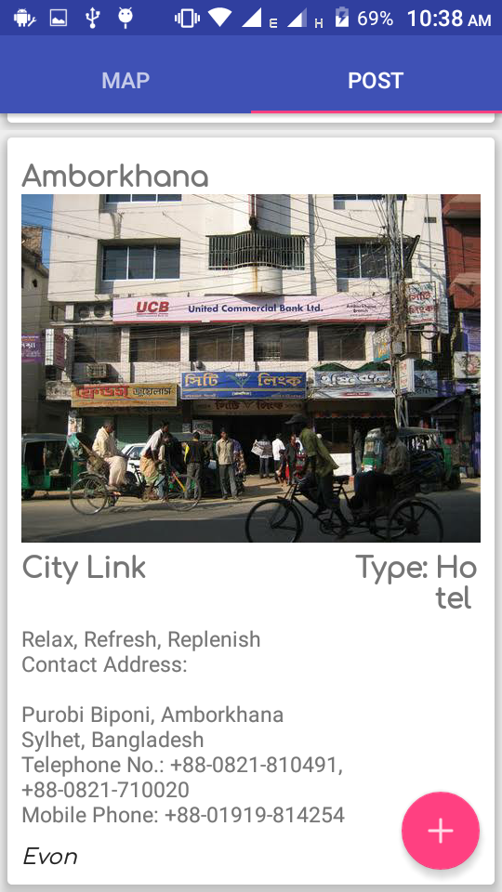
Showing in Feed:
Place your screenshot here
Posts based on user search is will be shown under post view fragment . Posts will include image , area , name of the place , and a description . It will also show the username of the post contributor.

Slide 11
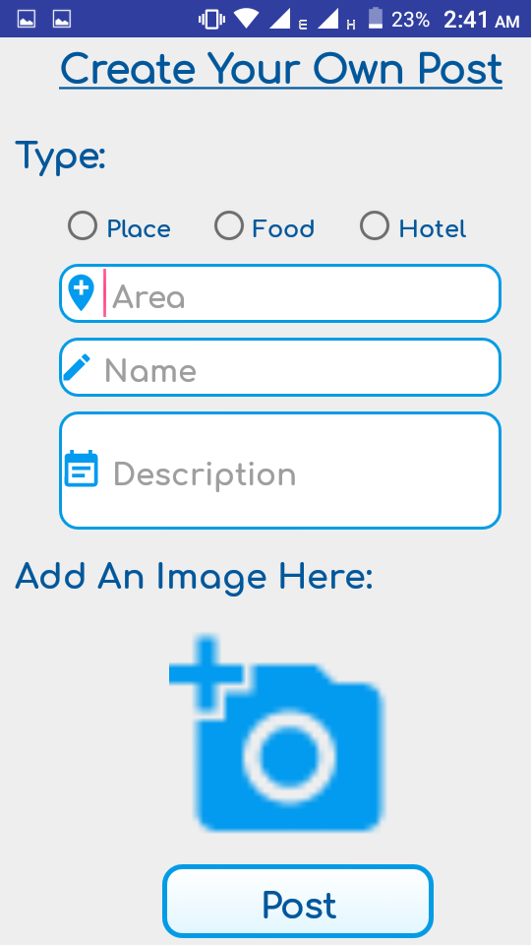
Create Post:
Place your screenshot here
User can create his own post. This activity requires certain informations and stored in firebase database.

Slide 12
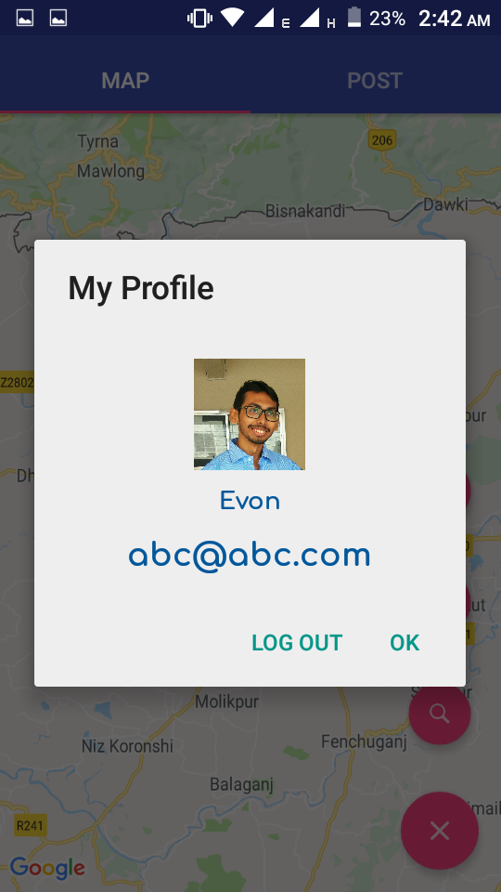
User Profile:
Place your screenshot here
User can see own profile by this dialogue box pop-up

Slide 13
GitHub Link:
This Project is uploaded in github :
https://github.com/tasmia2016831022/Tour-Guide-App

Slide 14
Thanks!

